Slide 1
Dimensionality Reduction with PCA-Understanding Eigen Vectors
-Ketaki Sonawane

Slide 2
Agenda
Using PCA solving the problem of dimensionality cruse, overfitting, and data visualization.
Understanding the role of eigen vectors and eigen values in PCA
What are PCA components?
How the dimension of the data get reduced?

Slide 3
Dataset
Source of the dataset : Kaggle
Name of the dataset : Digits dataset from sklearn library
Description
Each image is 28x28 pixels, and each feature simply represents one pixel’s intensity 0(white) to 255 (black)
Dimension of the dataset : 1790 rows and 64 columns

Slide 4
What is PCA?
Principal Component Analysis (PCA) is a dimensionality reduction technique that simplifies a dataset by transforming it into a smaller set of new variables (principal components) while preserving the most important information.
PCA achieves this by identifying patterns in the data, recognizing highly correlated features, and calculating the variance between them.
It was introduced by Karl Pearson in 1901.
It is a unsupervised learning algorithm.

Slide 5
Steps in PCA
1. Standardization of the data
Standardization is all about scaling your data in such a way that all the variables & their
values lie within a similar range.
2. Computing the covariance matrix
A covariance matrix expresses the correlation between the different variables in the
dataset.
3. Calculating the eigen vector and eigen values
Eigen vectors and eigen values are the mathematical constructs that must be computed
from the covariance matrix in order to determine the principal components of the
dataset.
4. Computing the principal components.
After calculating the eigen vector and eigen values, we arrange the PCA components in
descending order.
5. Reducing the dimensions of the data.
The last step in performing PCA is to re-arrange the original data with the final
principal components which represent the maximum and the most significant
information of the data set.

Slide 6
Thank You!

Slide 7
Business opportunities are like buses. There's always another one coming.
“
”
Richard Branson

Slide 8




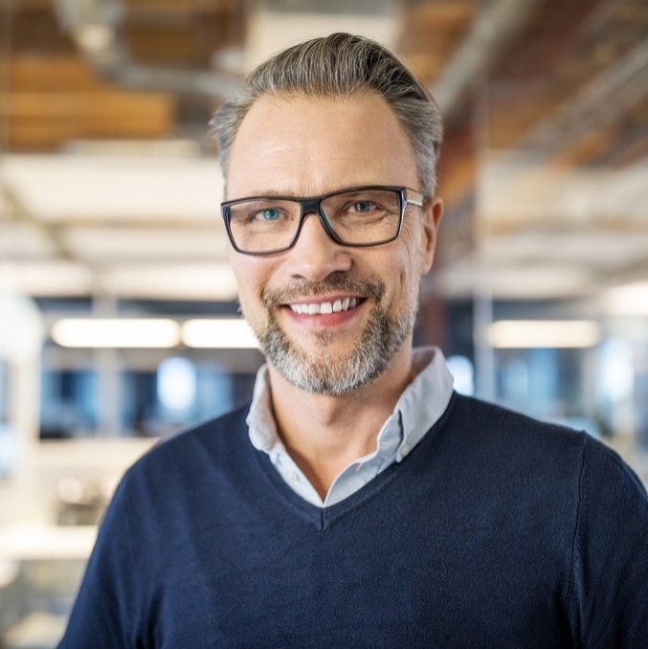



The full team
Takuma Hayashi
Mirjam Nilsson
Flora Berggren
Rajesh Santoshi
President
Chief Executive Officer
Chief Operations Manager
VP Marketing
Graham Barnes
Rowan Murphy
Elizabeth Moore
Robin Kline
VP Product
SEO Strategist
Product Designer
Content Developer

Slide 9
Plan for product launch
Deploy strategic networks with compelling e-business needs
Planning
Synergize scalable e-commerce
Marketing
Disseminate standardized metrics
Design
Coordinate
Foster holistically superior methodologies
Launch
Strategy
e-business applications
1
2
3
4
5

Slide 10
Timeline
Deploy strategic networks with compelling e-business needs
Sep 20XX
Synergize scalable e-commerce
Nov 20XX
Disseminate standardized metrics
Jan 20XX
Coordinate e-business applications
March 20XX
Foster holistically superior methodologies
May 20XX

Slide 11
How we get there
ROI
Niche Markets
Supply chains
Envision multimedia-based expertise and cross-media growth strategies
Visualize quality intellectual capital
Engage worldwide methodologies with web-enabled technologies
Pursue scalable customer service through sustainable strategies
Engage top-line web services with cutting-edge deliverables
Cultivate one-to-one customer service with robust ideas
Maximize timely deliverables for real-time schemas

Slide 12
Summary
At Contoso, we believe in giving 110%. By using our next-generation data architecture, we help organizations virtually manage agile workflows. We thrive because of our market knowledge and great team behind our product. As our CEO says, "Efficiencies will come from proactively transforming how we do business."

Slide 13
Thank you
Mirjam Nilsson​
mirjam@contoso.com
www.contoso.com

